Slide 1

FATİH İLİĞ

Slide 2
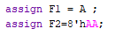
Operators
1. Assign operatör
Verilog uses the equal sign (=) to denote an assignment.
Continuous Assignment
Each individual assignment will be executed concurrently and synthesized as separate logic circuits. When simulated, these two lines of Verilog will make two separate signal assignments at the exact same time.
Notes:
Assign operatörü = ile gösterilir arkadaşlar. Her zaman sağdan sola doğru bir atama söz konusudur. Ayrıca atamalar aynı anda olmaktadır arkadaşlar. Yani C dili gibi sadece sıralı çalışan koddan farklı olarak, paralel bir şekilde çalışan bir dil yazıyoruz. Burada F1 ve F2 değişkenlerine değerler aynı anda atanacaktır.

Slide 3
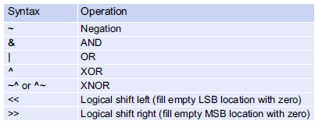
2. Bitwise Logical Operators
Bitwise operators perform logic functions on individual bits. The inputs to the operation are single bits and the output is a single bit. In the case where the inputs are vectors, each bit in the first vector is operated on by the bit in the same position from the second vector.

Slide 4
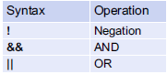
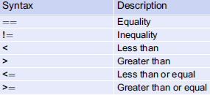
3. Boolean Logic Operators
4. Relational Operators

Slide 5
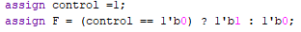
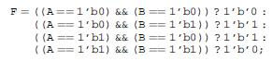
5. Conditional Operators
Inverter
Switch
XOR

Slide 6
6. Concatenation Operator
In Verilog, the curly brackets (i.e., {}) are used to concatenate multiple signals.

Slide 7
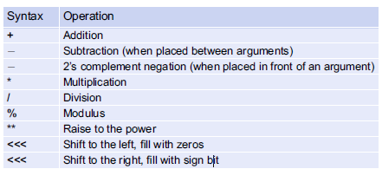
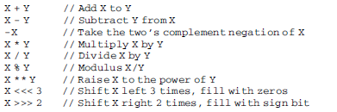
6. Replication Operator(Multiple Concatenation)
This operator uses double curly brackets (i.e., {{}}) and an integer indicating the number of replications to be performed.
7. Numerical Operators

Slide 8
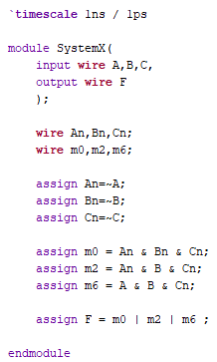
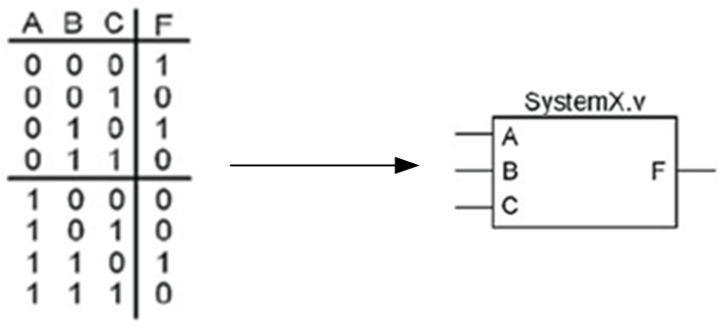
EXAMPLES
Continuous Assignment with Logical Operators
Example below shows how to design a Verilog model of a combinational logic circuit using continuous
assignment and logical operators.
Let’s implement the following truth table using continuous assignment with logical operators.

Slide 9
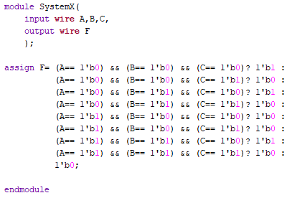
Continuous Assignment with Logical Operators
Example below shows how to design a Verilog model of a combinational logic circuit using continuous
assignment with conditional operators.
We can implement the entire truth table in its current form as follows:

Slide 10
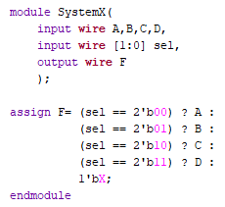
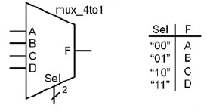
Multiplexer

